Slide 1
Destined 4 Greatness
Brandon Soncarty, Cason Nichols, Hannah Kosmicki, Nicholas Burlakov, Dillon Pikulik

Slide 2
Accessibility Accommodations
Blind
Deaf
Colorblind
Mobility Impaired

Slide 3
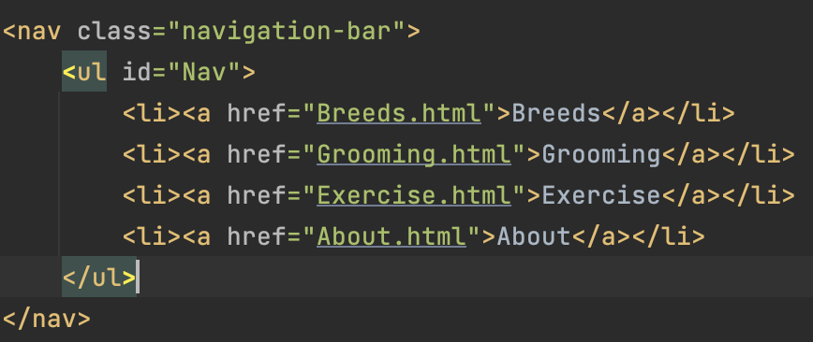
Accessibility - HTML
A good way to start according to MDN is by using the correct element for the job in HTML. This helps people who utilize screen readers
For example:

Slide 4
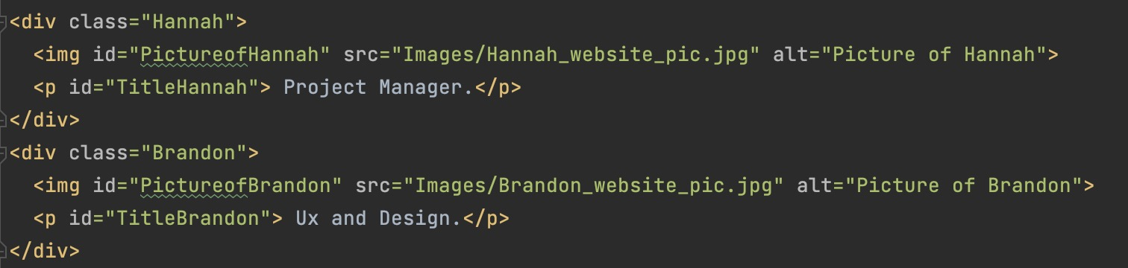
Accessibility - HTML
Another example:

Slide 5
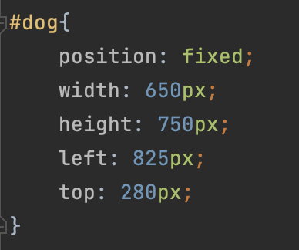
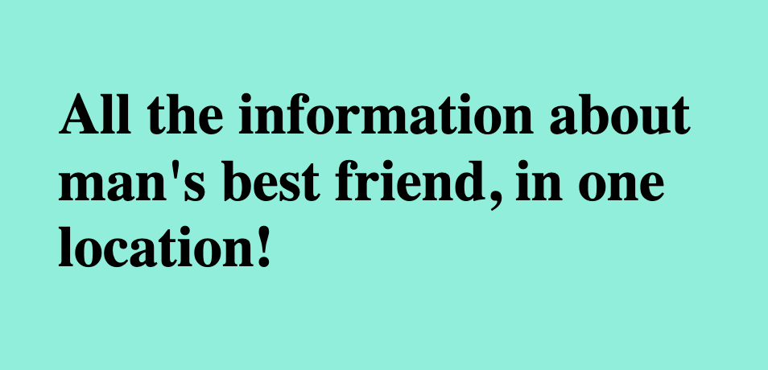
CSS & JavaScript
Use large images for our pages
Using contrasting colors for colorblind users

Slide 6
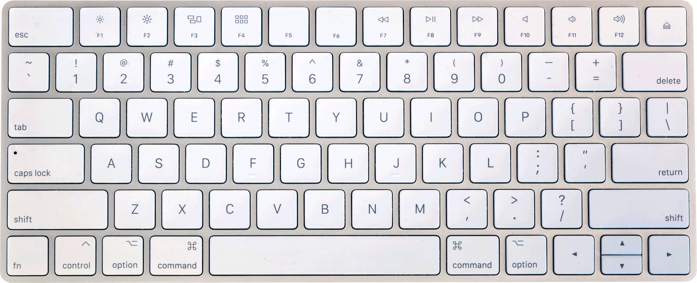
More Accessibility
Consider keyboard navigation: Make sure that all website functionality can be accessed via keyboard only.
This is important for people with mobility impairments who may not be able to use a mouse.

Slide 7
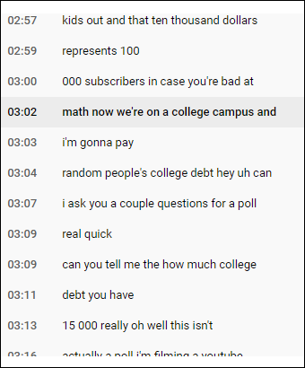
More Accessibility
Provide transcripts for videos: If our website includes videos, provide transcripts for them.
Critical for people who are deaf or hard of hearing

Slide 8
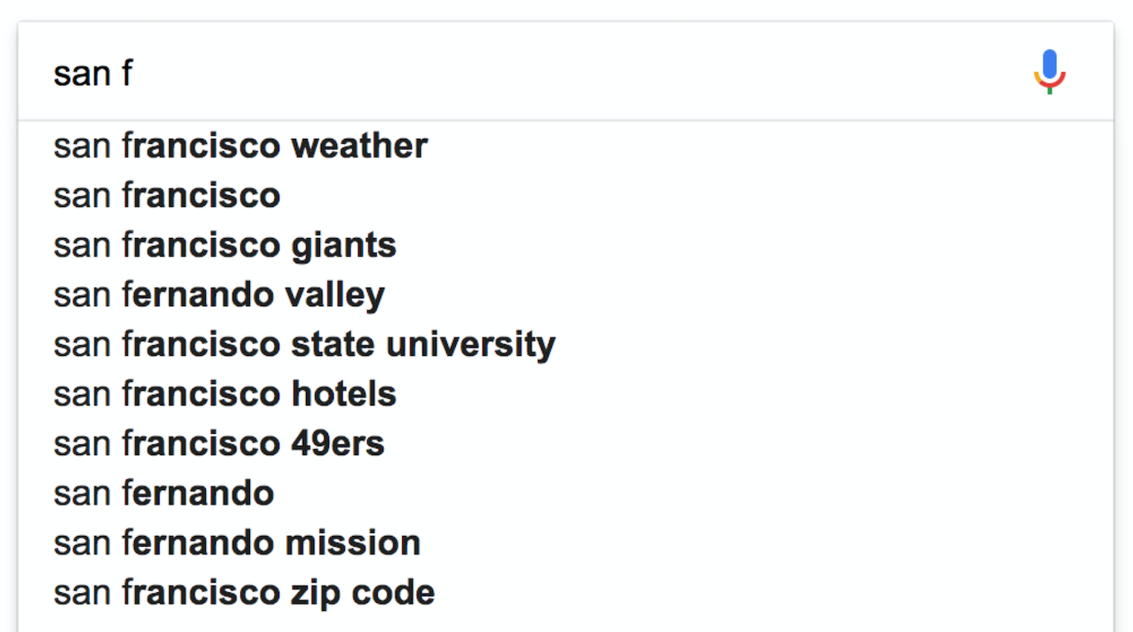
Input Assistance
Autofill feature for writing in data about your dog/dogs and etc.
This will increase better search results when calling to the database and can increase usability for everyone.
This will help people cut time typing and looking for the letters on the keyboad.

Slide 9
Testing
We will test our website with assistive technology:
Test our website with screen readers, keyboard-only navigation, and other assistive technologies to ensure that it's accessible to people with disabilities.

